Slide 1
Software Craftsmanship
Cédric HARTLAND

Slide 2

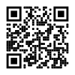
About
Cédric HARTLAND
Ph.D. in AI – UPSud, INRIA, CNRS
Courses in AI & CS since 20
2005 – 2010 – Researcher / Lecturer
2010 – 2017 – CAST
2017-2019 – Futurmaster
2019-2022 – Talentsoft
2022 – PlayPlay
2022+ - Thales Digital Factory
https://github.com/gigacool/craftsmanship-course

Slide 3
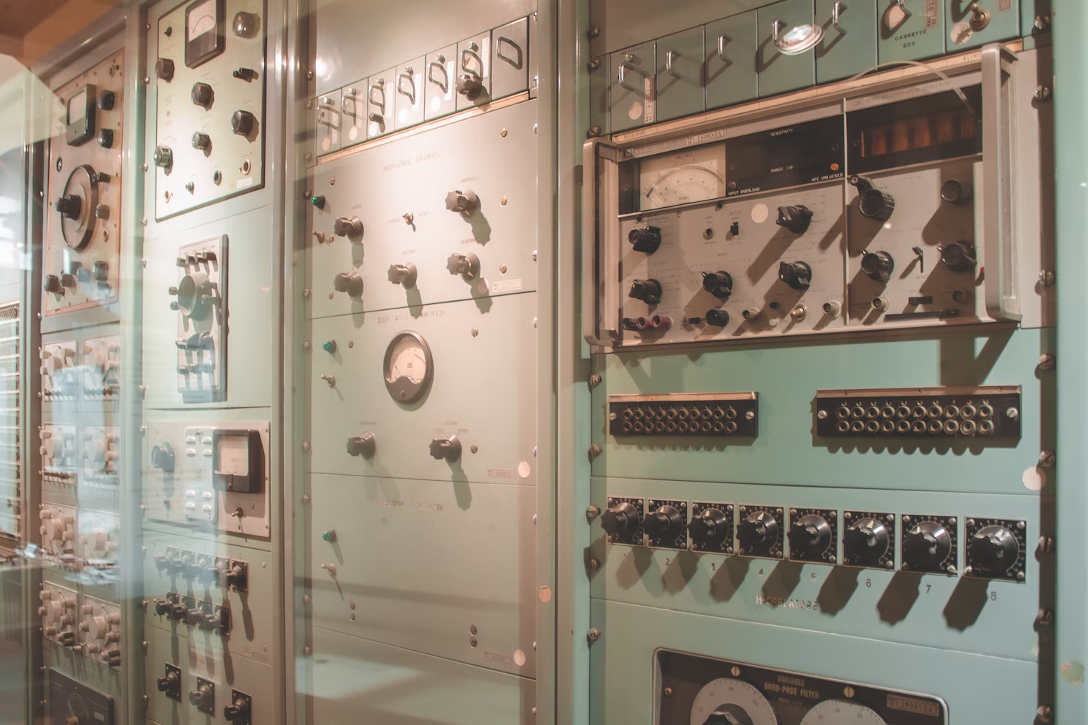


Software crisis, engineering & crafts

Slide 4
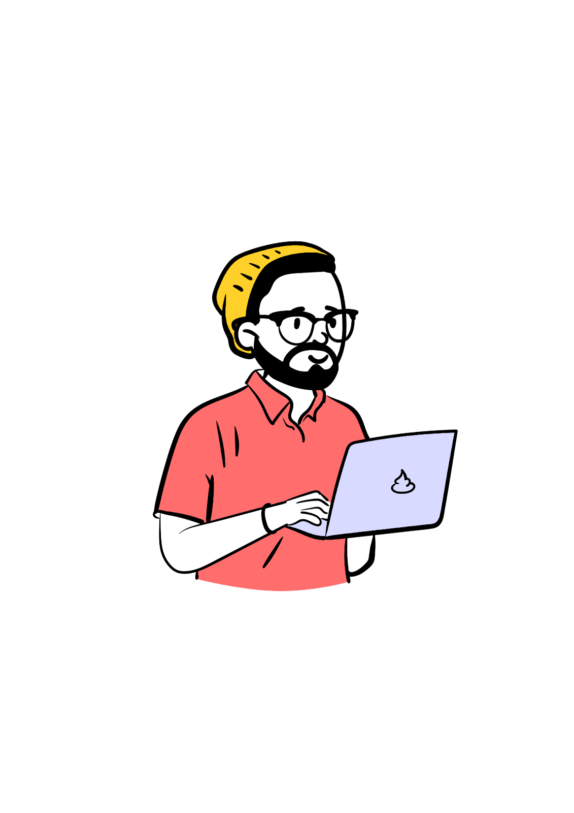
Developer ↮ Code
culture
Peer/mob
KISS
agile
CI/CD
SLA
DRY
methodology
hosting
monitoring
Best
practices
collaboration
UI
Clean
code
Happy Customer
DX
lean
User
driven
security
TDD
learning
Happy Users
Auto tests
UX
Database
SOLID
Programming language
professionalism
refactoring
Design patterns
architecture
OOP

Slide 5
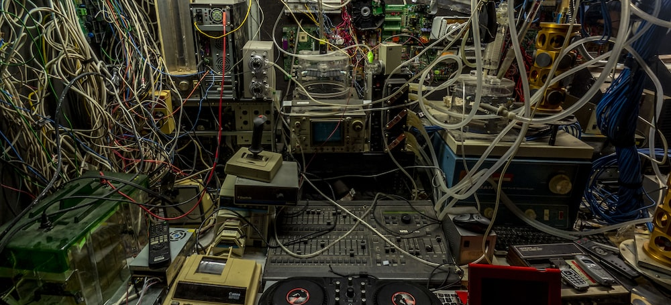
Flat sharing
Notes:
https://unsplash.com/photos/4h0HqC3K4-c

Slide 6

Craftsmanship in a nutshell
Collaboration

Slide 7




Craftsmanship in a nutshell
CARE
PRACTICE
LEARN
SHARE

Slide 8




Craftsmanship in a nutshell
Clean code
Design Patterns
Collaboration
Testing
Learning

Slide 9
Manifesto for Agile Software Development
We are uncovering better ways of developing software by doing it and helping others do it. Through this work we have come to value:
Individuals and interactions over processes and tools
Working software over comprehensive documentation
Customer collaboration over contract negotiation
Responding to change over following a plan
That is, while there is value in the items on the right, we value the items on the left more.
Notes:
http://manifesto.softwarecraftsmanship.org/#/en

Slide 10

Well-crafted software
Not only working software, but also well-crafted software Well-crafted == high quality code
Automated tests
Business language in the code
Appropriate design
Code quality is not guarantee of success
but can be the main cause of failure

Slide 11

Steadily adding value
Not only responding to change, but also steadily adding value constantly improve your code
Testable
Extendable
Refactoring
Boy scout rule always leave the campground cleaner than you found it

Slide 12

Community of professionals
Not only individuals and interactions, but also a community of professionals share / mentor
Knowledge
Ideas
Successes & failures
Craftsman want to work with passionate and inspiring professionals

Slide 13

Productive partnerships
Not only customer collaboration, but also productive partnerships we are not factory workers
Must help our clients / users
Must be able to say no for clients goods
Some clients are not ready harder to manage

Slide 14
Manifesto for Software Craftsmanship
Raising the bar.
As aspiring Software Craftsmen we are raising the bar of professional software development by practicing it and helping others learn the craft. Through this work we have come to value
Not only working software, but also well-crafted software
Not only responding to change but also steadily adding value
Not only individuals and interactions, but also a community of professionals
Not only customer collaboration, but also productive partnerships
That is, in pursuit of the items on the left we have found the items on the right to be indispensable.
Notes:
http://manifesto.softwarecraftsmanship.org/#/en

Slide 15
Developer eXperience
Challenges
Technical
Bugs
Technical debt
Coding practices
Working with others
Conflict management
Opinions
Teamwork
Customer pressure
« for yesterday »
« Not working »
Low quality
Have an
IMPACT
Technical
achievements
Infinite source
for learning

Slide 16
Course focus
Code
Clean code
Test & refactoring
Best practices
Ways of working
Agility
Collective programming practices
Contexts
Embedded, desktop, on premise, cloud

Slide 17
Testing applications
End 2 end tests
Integration tests
Unit tests
Notes:
https://gist.github.com/cedrickchee/55ecfbaac643bf0c24da6874bf4feb08

Slide 18
Manual testing
Just do it…
…but actually don’t

Slide 19

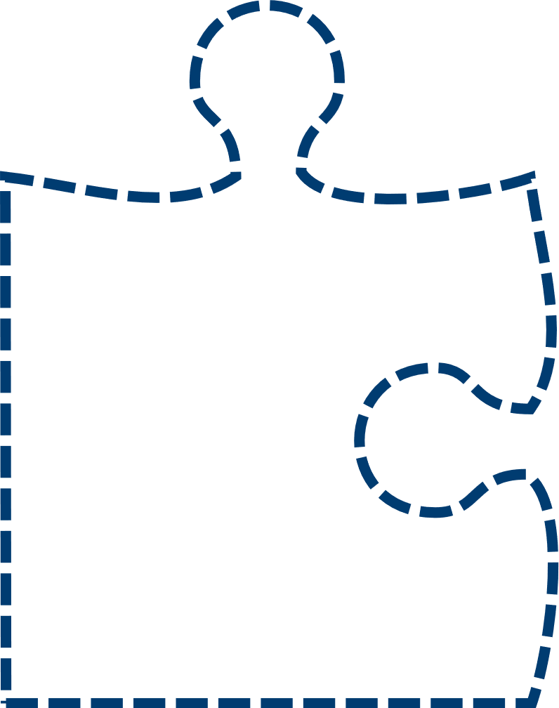

Unit test is a « code » specification
SUT System Under Test
Automated Tests brings confidence on code behavior
Code
+ Tests
Automated Tests act as specification
Potential bugs
Untold specifications
SUT
Specification
Spec changes
→ consequences
Code
+ no Tests
Wrong spec
→ wrong code

Slide 20
Assertion frameworks
assert.typeOf(foo, 'string’);
assert.equal(foo, 'bar’);
assert.lengthOf(foo, 3);
assert.lengthOf(beverages.tea, 3);
Different languages & frameworks → different opportunities
Technical Assertions
expect(foo).to.be.a('string’);
expect(foo).to.equal('bar’);
expect(foo).to.have.lengthOf(3);
expect(beverages).to.have.property('tea').with.lengthOf(3);
Behavior driven styles
Behavior focused DSL
Actual APIs depends on frameworks used
foo.should.be.a('string’);
foo.should.equal('bar’);
foo.should.have.lengthOf(3);
beverages.should.have.property('tea').with.lengthOf(3);

Slide 21






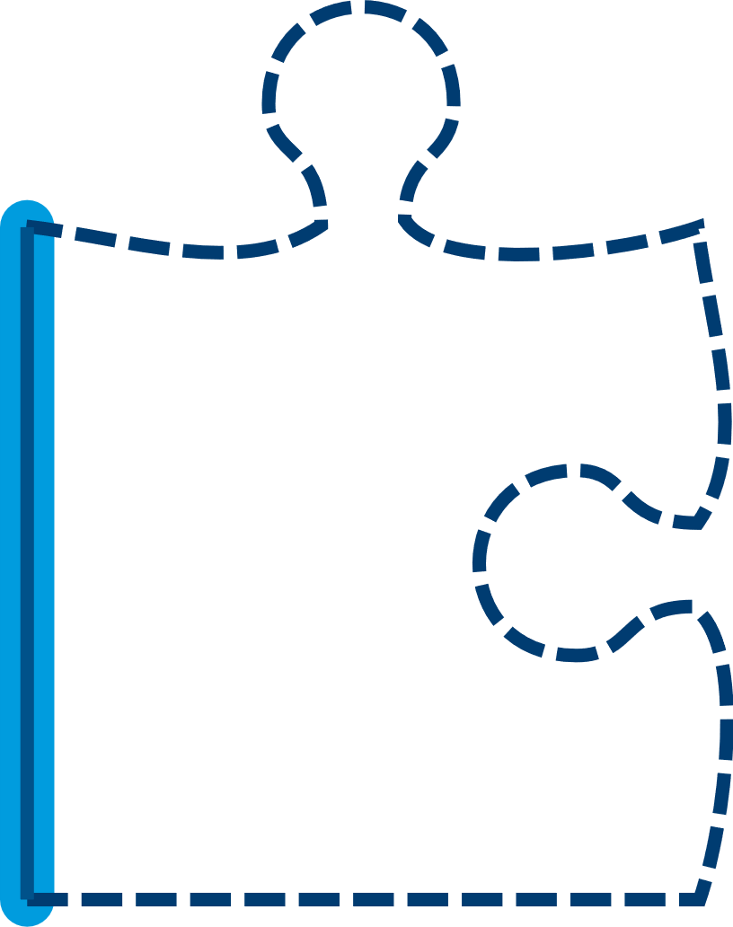



Code coverage
File count, functions, loc, branches
100%
80%
High coverage → less unplaned behaviors
50%
100% coverage is not 100% good
25%
0%
Aiming at 80% is Bu****it

Slide 22
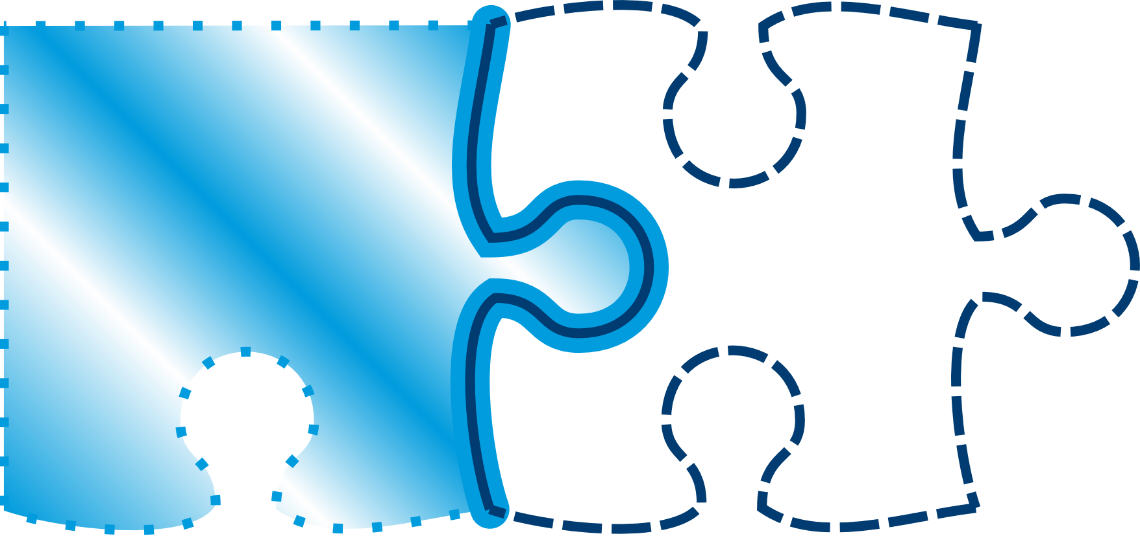
Test doubles
Different types
Stub ~ simulates behavior
Mock ~ substitutes to objects
Spy ~ wraps real functions
Fake ~ working fake implementations
Dummy ~ needed but unused resources
Mocking/doubling is often a mix of those
Doubles are expensive
Contract holder ? SUT ? Double target ?
Challenge the need for doubles
Loose coupling
Minimize risks for future evolutions

Slide 23
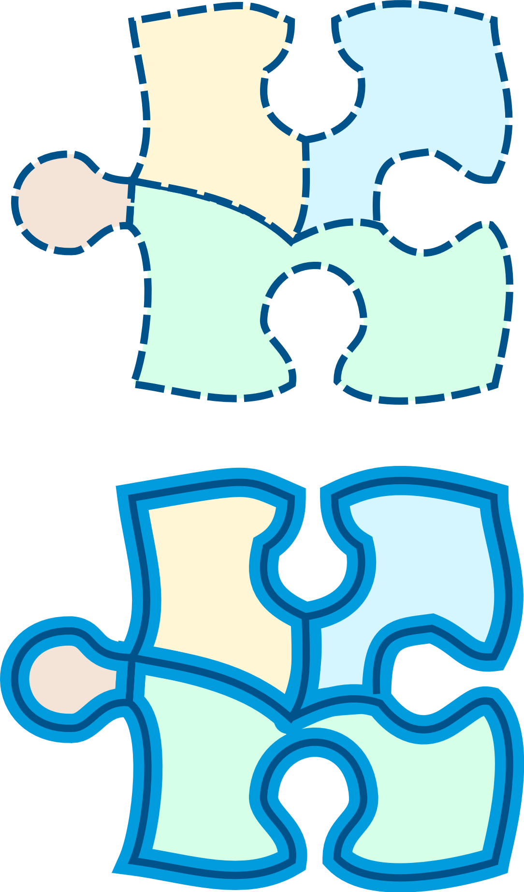

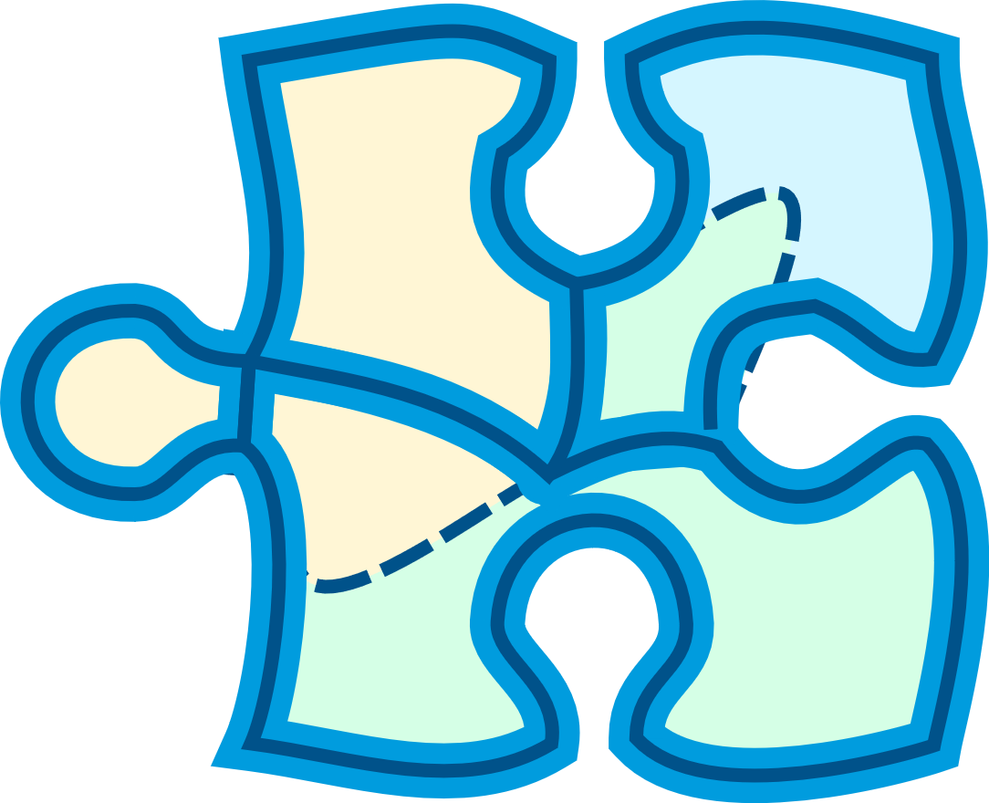
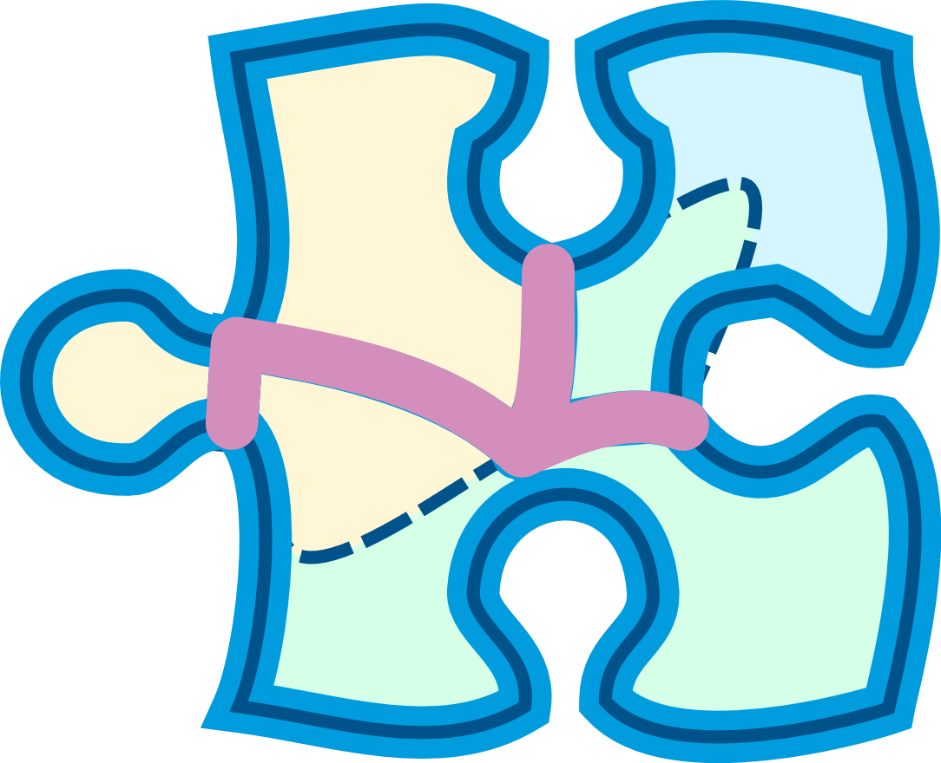
Testing private/internal organs
Testing private methods exposes them for potentially unwanted & unplanned usage
Testing internals limits refactoring ability
Focus should be on external behavior

Slide 24
TDD or not TDD
Don’t
E2e testing
Integration testing
Unit Testing
Do
E2e TDD
Integration TDD
Unit TDD
🤢 Your tests don’t actually test whay you think they test
When something can go wrong, it will go wrong
Your code design will suck
😀 Your tests expresses a contract
your tests validate expected behavior for sure
You will tend to have leaner and cleaner design

Slide 25
TDD Test Driven Development
Get higher confidence on test relevance
fail
correct
refactor
Enforce continuous refactoring
Focus on usage → loose coupling & lean code
Challenging techniques that helps designing sustainable code

Slide 26
TDD process
Write a test
Make it fail
Keep it simple
Test describe use case
Test describe technical spec
Clean up code
Keep test green
Change code, not behavior
Restructure one step after another
Get to green fast
Take baby steps
Stuck ? Undo & start over
Write only enough code to pass test
Don’t test external dependencies

Slide 27
Let’s code !
Example by code
fizzbuzz
String processing function (capitalize)

Slide 28
Just in case
One test ↔ 1 usecase ! 👩🏿‍🤝‍🧑🏻
🐾 Baby steps
Perf testing 😷

Slide 29
London vs. Chicago
Feature A
Feature A1
Feature A2
Inside out
Chicago
Outside in
London
Feature A1-1
Feature A1-2
+ of test doubles
Feature A1-1-1

Slide 30
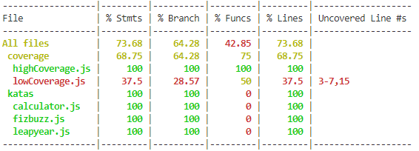
100% code cover-mir-age

Slide 31
ATDD Acceptance Test Driven Development
GIVEN a need for debugging specs
WHEN the 3 amigos align with the need
THEN there will be a shorter lead time
AND lower code rewrite
fail
Failing acceptance test
refactor
correct
It works !

Slide 32

Programmation collaborative
Notes:
https://unsplash.com/photos/QckxruozjRg

Slide 33
Efficient Collaboration
Pair
programming
Mob
programming
Code
Review
Doc as
Code

Slide 34




Pair programming

Slide 35



How to ?
Driver manages keyboard
Navigator provides guidance
Driver is in action
Navigator provides feedback
Driver
Pilot
Navigator
Copilot
Roles switches from time to time

Slide 36
Pair programming style – strong style
Driver writes the code
Navigator express solution
Driver is in action
Navigator provides feedback
Driver
Pilot
Navigator
Copilot
Roles are not switched

Slide 37
Pair programming style – silent style
Help building alignment
Let code speak out loud !!
Naming convergence
No one can talk, draw, comment
Refactoring helps share intention

Slide 38
Pair programming styles – ping pong
refactoring
Write green
code
Write red
test
Write green
code
Write red
test
refactoring

Slide 39
Pair programming styles – evil twin
refactoring
Write dumbest
Green code
Write red
test
Write dumbest
Green code
Write red
test
refactoring

Slide 40
Pair programming
Sometimes exhausting
Say yes when
agree
Say no when
disagree
Silence
stinks
Take breaks
Time boxed
Leap of faith sometimes
Don’t change roles
Share common objective
Retrospect
session
Open
communication
Everyone has own computer

Slide 41
Mob programming

Slide 42
code review
It’s all about the code
it’s not personal… it should not be
It’s a great learning tool
It’s an opportunity to reinforce alignment on practices
It’s a bug exposer
It’s a refactoring enhancer
It’s a collaborative tool
It’s a traceability utility
Keep it short and concise
Use some kind of conventional commit practices

Slide 43
Conventional commit
Code documentation is important… …but often overlooked
Message types
Feat
Fix
Refactor / perf
Style
Test
Docs
Build
Ops
Chore
Etc.
Message scope
Additional context
Subject
Summary
Body
Footer
good place for Breaking changes
type>(<optional scope>): <subject> _{empty separator line} <optional body> _{empty separator line} <optional footer>

Slide 44
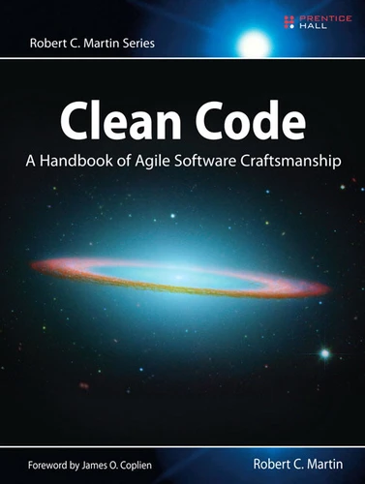
Clean Code fundamentals
https://gist.github.com/cedrickchee/55ecfbaac643bf0c24da6874bf4feb08
Notes:
https://gist.github.com/cedrickchee/55ecfbaac643bf0c24da6874bf4feb08

Slide 45
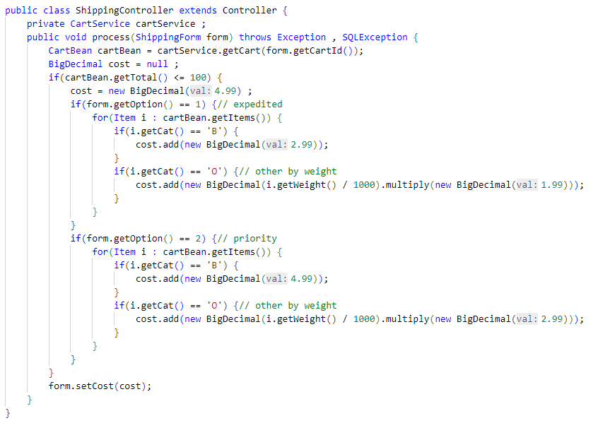
1 ↔ expedited ??
Magic Numbers ??
Copy paste (?)
B, O ??
Unit ?
Currency ?

Slide 46
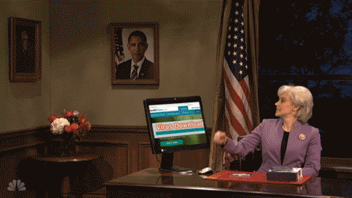
Clean code
Set of « best practices » or « code smells »
Technical design
Understandability
Naming
Function
Comments
Coding
Object oriented
Testing
Error handling
…

Slide 47
Rule of thumb 👍
Be professionnal
Always find root cause
Principle of least surprise
KISS and reduce complexity
Boy scout rul
DRY / DIE
Be a team player
Follow company / team standard conventions
Do not override safeties
Be a lead material
& lead by example
Demonstrate your expertise
& respect other’s work

Slide 48
Design rules
Keep configurable data at high level
They should be easy to change
Separate multi-threading code
Prevent over-configurability
Use dependency injection
Loose coupling
Class A
uses
Service
Builder
creates
inject
Class A
Service
uses
IService

Slide 49
polymorphism
public class Polymorphism {
public void dontDo(String message, String details){ if (details != null){
System.out.println(message + "\n" + details);
} else {
System.out.println(message);
}
}
public void doInstead(String message){
System.out.println(message);
}
public void doInstead(String message, String details){
doInstead(message);
System.out.println(details);
}
}

Slide 50
Law of Demeter
Each unit should have limited knowledge about other units
(unless closely related)
Each unit should only talk to its (immediate) friends
(don’t talk to strangers)
Notes:
Each unit should have only limited knowledge about other units: only units "closely" related to the current unit.
Each unit should only talk to its friends; don't talk to strangers.
Only talk to your immediate friends.

Slide 51
Understandability
Be consistent
Whatever the way, stick with it
Use explanatory variables
Encapsulate boundary conditions
Prefer dedicated value objects
to primitive type e.g. name, date, etc.
Avoid negative conditionals

Slide 52
Names rules
Choose descriptive and unambiguous names
Make meaningful distinction
Use pronounceable names
Use searchable names
Replace magic numbers with named constants
Avoid encodings
Don’t append prefixes or type information

Slide 53
Functions rule
Keep them small
Do one thing
And do it well
Use descriptive names
Prefer fewer arguments
≤ 3 arguments
Have no side effects
Don’t use flag arguments
Split method into several independent methods

Slide 54
Comment rules
Always try to explain with code
Not with comments
Don’t be redundant
i++; // increment i 😫
Don’t add obvious noise
Don’t use closing brace comments
E.g. // end of function
Don’t comment out code
Just remove it
Use as explanation of intent
Use as clarification of code
Use as warning of consequence

Slide 55
Source code structure
Separate concepts vertically
Related code should appear vertically dense
Declare variables close to their usage
Dependent functions should be close
Similar functions should be close
Place functions in the downward direction
Keep lines short
Don’t huse horizontal alignment
Use white space to associate related thing and disassociate weakly related
Don’t break indentation

Slide 56
Objects and data structures
Hide internal structure
Prefer data structure
Avoid hybrids structures
Should be small
Do one thing
Small number of instance variables
Base class should know nothing of their derivatives
Better to have many functions than to pass some code into function to select a behavior
Prefer non-static methods to static methods

Slide 57
Tests
One assert per test
Fast
Independent
Repeatable
self-validating
Timely
Readable
Easy to run
Use a coverage tool

Slide 58
Code smells
Rigidity
Software difficult to change; a small change causes a cascade of subsequent changes
Fragility
The software breaks in many places due to a single change
Immobility
You cannot reuse part of the code in other projects becose of involved risks and high effort
Needless complexity
Needless repetition
Opacity
The code is hard to understand

Slide 59
Error handling
Don’t mix error handling and code
Use exceptions instead of returning error codes
Don’t return null
Don’t pass null either
Throw exceptions with context

Slide 60
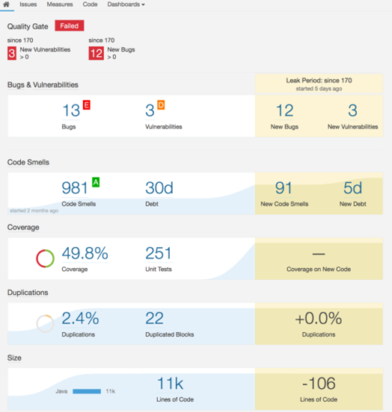
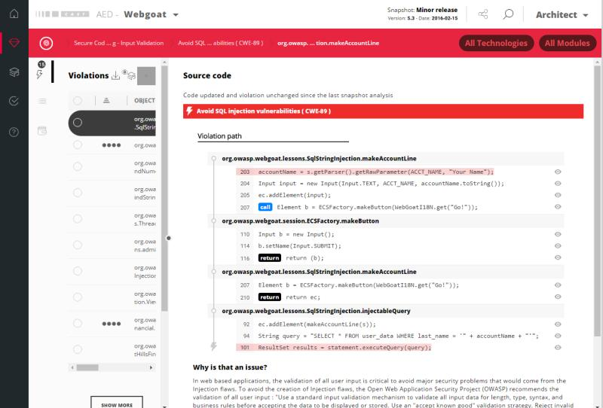
Technical debt
Everything that breaks your productivity
wrong technical designs, little tests, code readability, bugs, crappy doc, process mess, fuzzy requirements, high lead time, …

Slide 61
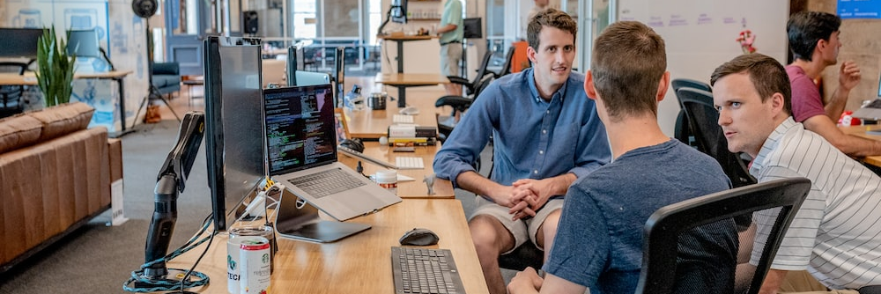
Refactoring
Notes:
https://unsplash.com/photos/mpN7xjKQ_Ns

Slide 62

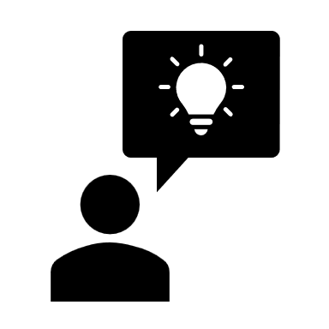


Refactoring
?
?

Slide 63
Prerequesites
When to refactoring ?
(SOLID, KISS, Demeter, etc.)
Know refactoring patterns
Get a hold on your IDE and make it nobrainer
No test / no refactoring

Slide 64
Refactoring practices
Renaming
Make it clearer
Reinstate intention and semantics
Extraction
Break code in multiple smaller parts
Reinforce abstractions
Reduce duplicates
Inline
Opposite to extraction
Reorganize code lines
Regroup functional blocks
Rewrite conditionals
Rewrite loops
Change method signatures
Move
More elaborate & complex situations
Mikado refactoring methdod
Prerequesites & experiments

Slide 65
Rewritting conditionals
Reverse if/else
Improve condition understanding
Convert to ternary and vice-versa
Simplify complex conditions
Combine multiple if/else
Convert to switch
Reduce indentation depth
Complexity
Fail fast, return asap
Reduce duplicates
Notes:
De morgan

Slide 66
Let’s code
Tennis app

Slide 67
DDD - draft
Focus on the DOMAIN
Use language of the domain ubiquitous language
Concepts
Bounded contexts
Entities and value objects
Aggregates and repositories -
Domain events – significant domain changes as events to enable reactive, decoupled architecture
Benefits – just do it
Clear domain logic
Alignment
Scalability

Slide 68
The multiverse of acronyms
KISS Keep It Simple Stupid
DRY Don’t Repeat Yourself
YAGNI You Ain’t Gonna Need It
DIE Duplication Is Evil
OOP Object Oriented Principles
SOLID
SRP Single Responsibility Principle
OCP Open/Closed Principle
LSP Liskov Substitution Principle
ISP Interface Segregation Principle
DIP Dependency Inversion Principle
ASMM And So Much More !

Slide 69
Patterns & others
OOP/SOLID

Slide 70
The missing pieces
OOP/SOLID
Design patterns
World of services

Slide 71
OOP
Classes class-based vs. Prototype based
Variables
Methods
Objects
Data abstraction & encapsulation
Hide how it works inside
Composition, inheritance
Delegation
polymorphism

Slide 72
S.O.L.I.D
// not S
class Employee {
public calculateSalary (): number { /* code... */ }
public hoursWorked (): number { /* code... */ }
public storeToDB (): any { /* code... */ }
}
// S
abstract class Employee {
abstract calculateSalary (): number;
abstract hoursWorked (): number;
protected storeToDB ():any { /* code ... */ }
}
class Technical extends Employee {
calculateSalary (): number { ….code }
hoursWorked (): number {...code }
}
class Finance extends Employee {
calculateSalary (): number {...code}
hoursWorked (): number {..code}
}
Single Responsibility Principle
Low coupling, high cohesive
who’s going to use it ? How change would impact ?

Slide 73
S.O.L.I.D
Open/close principle
class Rectangle {
public Width (): number {/* code... */}
public Height (): number {/* code... */}
}
class Area {
public compute(shapes: Rectangle[]): number {
return shapes.reduce((total, shape) =>
total + shape.Width() * shape.Height()
, 0);
}
}
Open for extensions
Closed for change

Slide 74
S.O.L.I.D
Open/close principle
class Rectangle {
public Width (): number {/* code... */}
public Height (): number {/* code... */}
}
class Circle {
public Radius (): number {/* code... */}
}
class Area {
public compute(shapes: any[]): number {
return shapes.reduce((total, shape) => {
if (shape instanceof Rectangle){
let rectangle = (shape as Rectangle);
return total + rectangle.Width() * rectangle.Height()
}
if (shape instanceof Circle){
let circle = (shape as Circle);
return total + circle.Radius() * circle.Radius() * Math.PI;
}
}
, 0);
}
}
Open for extensions
Closed for change

Slide 75
S.O.L.I.D
Open/close principle
abstract class Shape {
public abstract area(): number;
}
class Rectangle extends Shape {
public Width (): number {/* code... */}
public Height (): number {/* code... */}
public area(): number { /*...*/ }
}
class Circle extends Shape {
public Radius (): number {/* code... */}
public area(): number { /*...*/ }
}
Open for extensions
Closed for change

Slide 76
S.O.L.I.D
abstract class Animal {
public pet():void;
}
class Cat implements Animal {
public pet():void { /* code ... */}
}
class Dog implements Animal {
public pet():void { /* code ... */}
}
class Foo<T> {
public bar(cat: Cat): number { /* code... */}
}
Liskov substitution principle
Objects of a superclass should be replaceable with objects of subclasses

Slide 77
S.O.L.I.D
abstract class Animal {
public pet():void;
}
class Cat implements Animal {
public pet():void { /* code ... */}
}
class Dog implements Animal {
public pet():void { /* code ... */}
}
class Foo<T> {
public bar(animal: Animal): number { /* code... */}
}
Liskov substitution principle
Objects of a superclass should be replaceable with objects of subclasses
Inheritance can be hard to foresee (e.g. gas car, electric car)

Slide 78
S.O.L.I.D
Interface segregation principle
interface DoAll {
public a():number;
public b():number;
public c():number;
//...
public z():number;
public menage():number;
public vaisselle():number;
public lessive():number;
public lessiveRapide():number;
public lessiveFragile():number;
public lessiveTresSale():number;
public secheLinge():number;
public cafe():number;
public etPlus():number;
}
class doItAll implements DoAll {
// good luck to users (and devs)
}
interface DoAtoC {
public a():number;
public b():number;
public c():number;
}
// ...
interface Lessive {
public lessive():number;
public lessiveRapide():number;
public lessiveFragile():number;
public lessiveTresSale():number;
}
class doSome implements DoAtoC, DoDtoF, DoYtoZ {
// code ...
}
Keep it user friendly

Slide 79
S.O.L.I.D
Dependency inversion principle
Don’t add coupling
class IPhone {
public call(phoneNumber: number): void { /* code... */}
}
class PhoneOwner {
public callFriend(phone: IPhone): void { /* code... */}
}
PhoneOwner
IPhone

Slide 80
S.O.L.I.D
Dependency inversion principle
Don’t add coupling
interface Phone {
public call(phoneNumber: number): void;
}
class IPhone implements Phone {
public call(phoneNumber: number): void { /* code... */}
}
class PhoneOwner {
public callFriend(phone: Phone): void { /* code... */}
}
PhoneOwner
<<interface>>
Phone
uses
implements
IPhone

Slide 81
Design patterns
https://refactoring.guru/fr/design-patterns

Slide 82
Patrons de création
Fabrique
Fabrique abstraite
Monteur
Prototype
Singleton

Slide 83
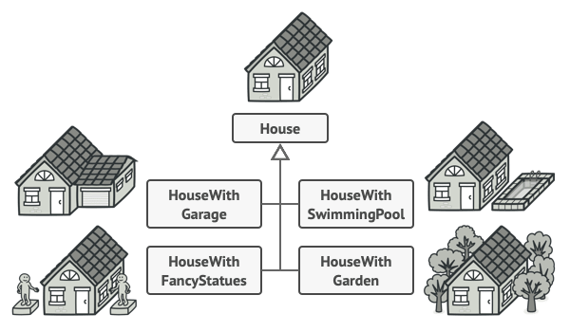
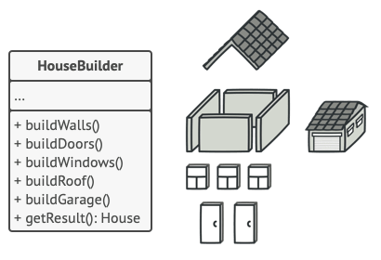
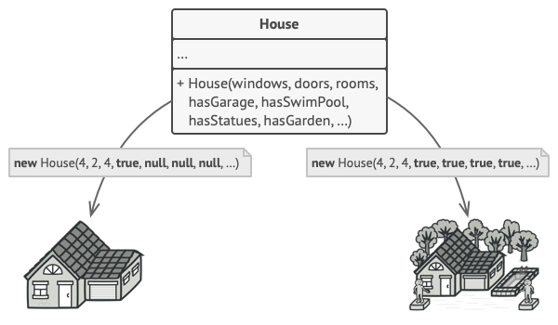
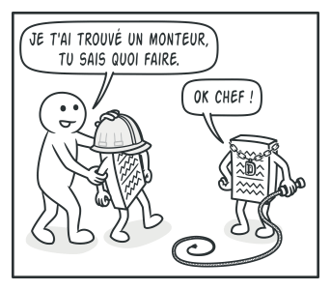
Builder + Director

Slide 84
Patrons structurels
Adaptateur
Pont
Composite
Décorateur
Façade
Poids mouche
Procuration

Slide 85
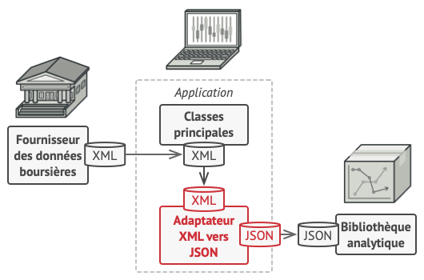
Adapter

Slide 86
Patrons comportementaux
Chaine de responsabilité
Commande
Itérateur
Médiateur
Mémento
Observateur
État
Stratégie
Patron de méthode
Visiteur

Slide 87
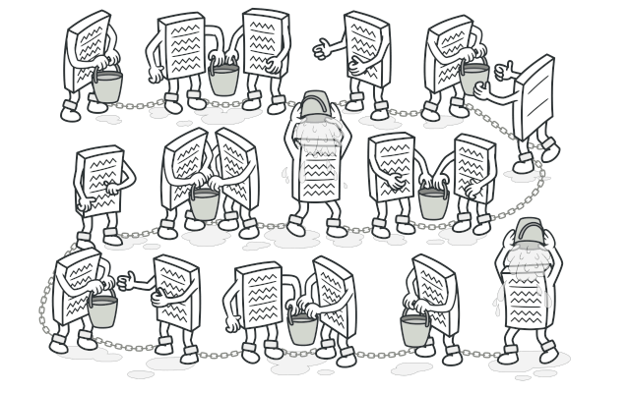
Chain of responsibility

Slide 88
Example
{
const express = require('express');
const app = express();
let counter = 0;
const requestNumber = function(req, res, next){
req.counter = ++counter;
next()
}
app.use(requestNumber);
const logger = function(req, res, next){
console.log('log', req.params.id);
next();
}
app.use(logger);
const authorize = function(req, res, next){
if (/* requester isAuthorized */){
return next();
}
res.status(401)
}
app.use('/api', authorize);
app.get('/api/:id', function(req, res, next){
// is called after logger
req.send(req.params.id);
})
app.listen(3000);
}
API controler middleware
{
const express = require('express');
const app = express();
app.get('/api', function(req, res, next){
req.send('ok');
})
app.listen(3000);
}

Slide 89
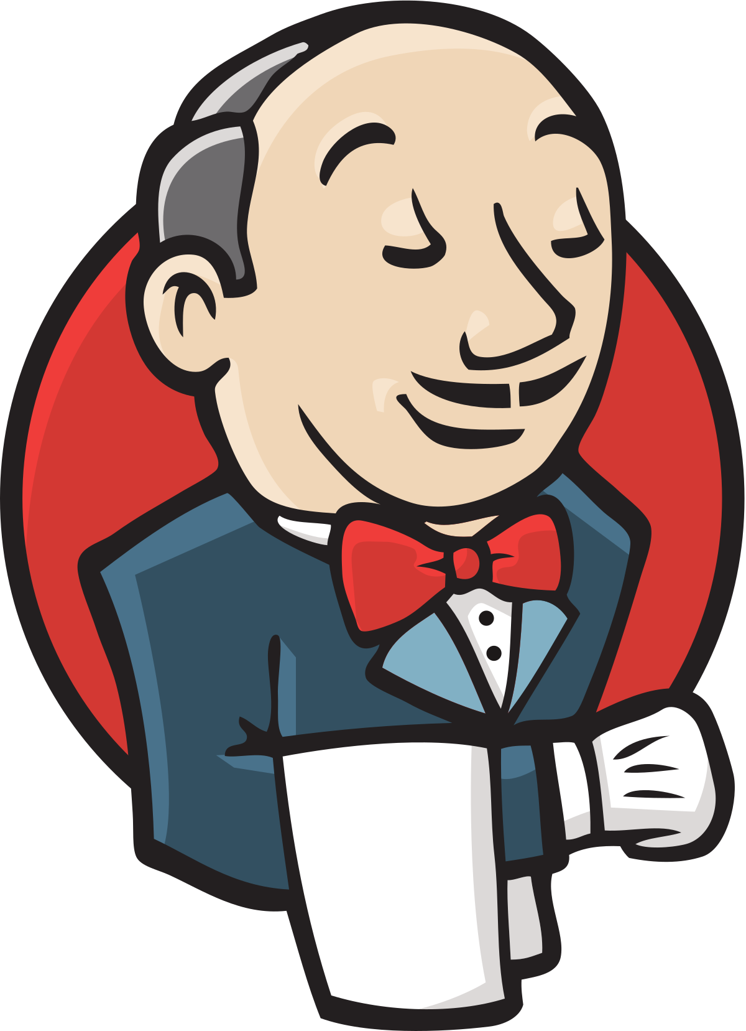
World of services

Slide 90
Process communication
Local
Pipe cat file > other-file
File write/read
Signal notify to process
Shared Memory between different processes
Socket local network system (tcp/udp)
Network / distant
Socket network system (tcp/udp)
Message Queuing middleware
API
Stateful / Stateless
CRUD / Method invocation
SOAP / RMI / REST / GRAPHQL
OpenAPI (OAI) standardize how APIs are described
Formats
Xml
Json
Yaml
Protobuf
…
Beware to
loose coupling
Notes:
RMI / Remote Method Invocation
CRUD / Create Read Update Delete

Slide 91
Software Architecture
monolith
N-tiers
µ-services
app
Web tier
API gateway
msg
Middle tier
service
service
service
Middle tier
cache
Data tier
service
service
Remote
service

Slide 92
API – Command and Query Responsibility Segregation
presenter
presenter
Separate
read / update
validation
validation
performance
commands
Business logic
Domain logic
Data layer
scalability
Data persistence
Read query
Write model
Read model

Slide 93
API – Event sourcing
Events are immutable
presenter
presenter
Events are domain oriented actions
Easier to trace than complex data models state
Cart created
validation
Materialzed view
Other
system
Item #1 added
Business logic
Item #2 added
Prevents concurrent updates
Data layer
Item #1 removed
Query for curent state of entities
Audit trail
Event store

Slide 94
Bootstrapping project
Explore
Expand
Extract
Build first stack
Ease product iterations
Extend architecture
Long running tasks, frequent updates
Handle growth
Scale, compliance, maturity

Slide 95




BDD and layers of code
app
People & systems interact with your app
Domain driven
Decouples business domain from the technology

Slide 96
BDD
business value
Infrastructure
UI, DB, web APIs, Frameworks
Domain code uses
Ubiquitous language
Between users and devs
Domain
Business logic
technology
Domain centric architecture aims at protecting the domain

Slide 97
BDD – hexagonal architecture
Adapters are how app interacts with the world
Infrastructure
adapters
e.g. how domain interacts with database
Domain
Primary (driving)
Secondary (driven)
Notes:
https://alistair.cockburn.us/hexagonal-architecture/

Slide 98
Clean architecture
Enterprise business rules
devices
controllers
web
Application business rules
Use cases
Interface adapters
entities
Frameworks & drivers
gateways
presenters
UI
DB
External
interfaces

Slide 99
Clean architecture example flow
view
web
Presentation
layer
presenter
controllers
Use cases
entities
Domain
layer
Use case
entity
repository
repository
database
Data
layer
Database

Slide 100
Clean architecture
Business logic code should be
independent from frameworks
Testable
Independent from user interface
Independent from database
Independent from external services

Slide 101
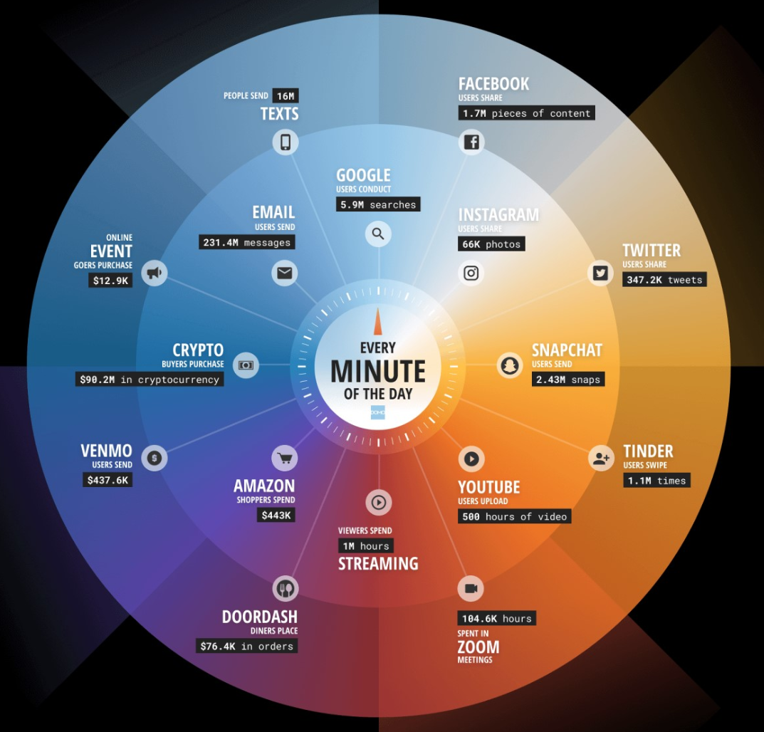
It’s not all web…
A world of services

Slide 102
As a developer
Why should I care about hardware failure ?
Infrastructure as a Service
Why must I manage the operating system, JVM and other dependencies ?
Platform as a Service
I don’t know nothing about SQL Server, I just want a database !
Platform as a Service / Software as a Service
Why create it when I can use it ?
Software as a Service

Slide 103
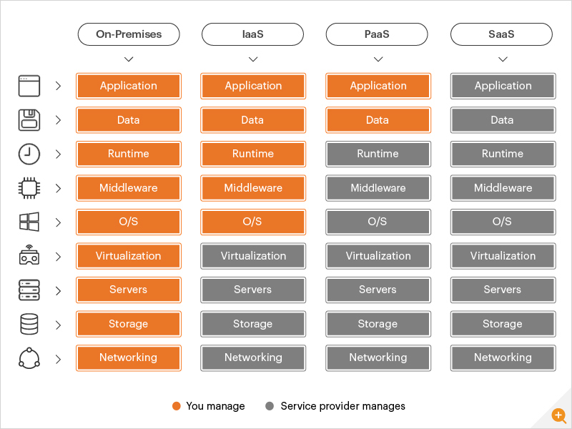
On-premise, IaaS, PaaS, SaaS

Slide 104
Eco-conception
sobriety
circularity
safety

Slide 105
Strategies
Avoid engineering excess Circularity
Reduce product size (whole or parts)
Architecture, code, features, etc.
Maximize server load
Adapt resources to load
Increase/decrease resources per usage / system state
Smart solutions rather than “large”
Support real use cases
Redistribute
Organize architecture according to computation constrains (e.g. edge, hyperscallers, gpu, AI chips)
sobriety
safety
circularity
sobriety
sobriety
sobriety
sobriety
sobriety

Slide 106
Strategies
Evolutive and long-lasting solutions
Modularity enable reuse of the solution
Be consistent with actual end life
Hardware – to remove (?)
Reuse resources
Materials, libraries, services – guarantee right size
Avoid dangerous or controversial materials
Health, branding
Inspire from nature, biomimetics
Strong optimizations
sobriety
circularity
safety
circularity
circularity
safety
sobriety
safety

Slide 107
Wrap-up

Slide 108
Software Craftsmanship in a nutshell
Quality
Clean code, refactoring, tests, simple design, TDD
Humility
Challenge yourself, continous improvement
Sharing
pair programming, collective ownership of source code
Pragmatism
understand constraints, adapt!
Professionalism
Treat your client as a partner

Slide 109
Software craftsmanship
Clean code, SOLID, Design pattern
Methodologies
Technical : TDD, DDD
Organizational : agility, SCRUM, Kanban
Mindset : (learn, fail, repeat,)^{n} then succeed

Slide 110
References
Clean Code: A Handbook of Agile Software Craftsmanship, by Robert C. Martin (aka Uncle bob)
Software craft, TDD, Clean code et autres pratiques essentielles, par C. Martraire, A. Thiéfaine, D. Bartaguiz, F. Hiegel, H. Fakih
Zero bugs and program faster, by Kate Thompsohn
The problem with software, why smart engineers write bad code, by Adam Barr
Blogs
https://martinfowler.com
http://blog.xebia.fr
https://blog.octo.com

Slide 111
Pictures comes from unsplash.com
Avatars from open peeps flat assets
Manifesto for software craftsmanship http://manifesto.softwarecraftsmanship.org/#/en
https://github.com/fmbenhassine/awesome-software-craftsmanship

Slide 112
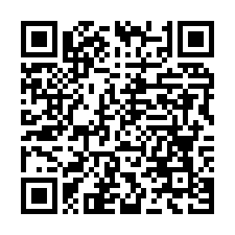
Test # 1
5-10 minutes

Slide 113
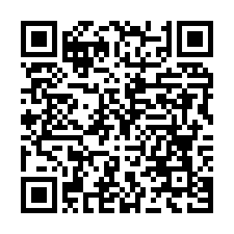
Test # 2
5-10 minutes

